Slide 1
HFrEF Treatment
HFrEF:
Initiate Guideline Directed Medical Therapy (GDMT) – 4 mainstays
Begin with volume management using aldosterone antagonists w or w/o loop diuretics as needed
Beta blockers (metoprolol succinate, carvedilol, bisoprolol), and ARNI/ACEI/ARB for all unless contraindicated
Titrate to target dose, even if symptoms are stable/improving
Get BP as low as tolerated. HR target 70bpm or less
Add SGLT2 inhibitor: Dapagliflozin (Farxiga®), Sotagliflozin (Inpefa®) and Empagliflozin (Jardiance®) are approved for HFrEF . Hold 3d prior to surgery. Only Sotagliflozin (Inpefa®) needs titration and renal concerns. (See HFpEF section).
Notes:
2022 AHA/ACC/HFSA Guideline for the Management of Heart Failure: A Report of the American College of Cardiology/American Heart Association Joint Committee on Clinical Practice Guidelines
AHA/ACC/HFSA CLINICAL PRACTICE GUIDELINE

Slide 2
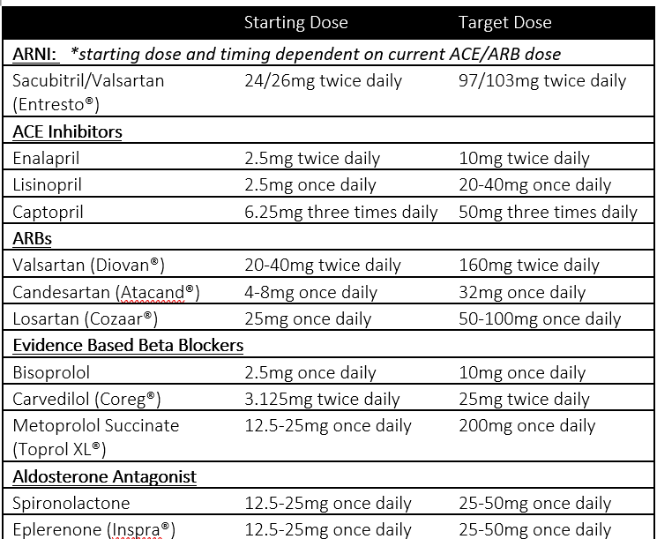
HFrEF Treatment
For ALL patients:
ACE Inhibitor or ARB or ARNI
AND Evidence based Beta Blocker
AND Aldosterone Antagonist (CrCl >30 ml/min, K⁺ <5)
AND SGLT2 inhibitor
Titrate ACE/ARB/ARNI, BB, Aldosterone Antagonist to target doses as clinically tolerated
Continue diuretic prn or daily
Follow up symptoms q1-6 months and prn
Initiate loop diuretic
(dose prn or daily as clinically indicated)

Slide 3
HFrEF Subsequent Treatment
If persistent symptoms, continue to add as appropriate (Begin → End)
Add Hydralazine/ISDN (decrease mortality): self-identified African American or contraindication to ACE/ARB/ARNI
Add Ivabradine (Corlanor®) (decrease time to hospitalization): HR >70 on max tolerated BB and in normal sinus rhythm
Consider addition of Digoxin if patient w/ symptoms despite above therapies or if comorbid atrial fibrillation. Use low dose, ensure K⁺ and Mg⁺ are WNL
Consider Vericiguat (Verquvo®)(decrease CV death & HF hospitalization): eGFR >15 ml/min, EF <45%, contraindicated in pregnancy

Slide 4
HFpEF Treatment
HFpEF:
Start with loop diuretics for volume management. If significant edema despite loop, add aldosterone if eGFR/K+ normal
Get BP and HR as low as tolerated – use beta blockers, diltiazem, verapamil (rate – 70bpm is target) as well as ACEI/ARB and consider nitrates, hydralazine
Add SGLT2 Inhibitor (note to hold med at least 3d prior to surgery – DKA risk)
Empagliflozin (Jardiance®) – FDA approved for all types HF – no titration
Start 10mg qam as long as eGFR >/= 20.
Dapagliflozin (Farxiga®) – FDA approved for all types HF – no titration
Start 10mg qam. Avoid initiation of treatment if eGFR <25. May stay on if eGFR drops <25
Sotagliflozin (Inpefa®) – FDA approved (05/2023) – HF titration
Start 200mg qd, increase after 2wk. eGFR must be > 25 to start, do not use if < 15
Notes:
2022 AHA/ACC/HFSA Guideline for the Management of Heart Failure: A Report of the American College of Cardiology/American Heart Association Joint Committee on Clinical Practice Guidelines
AHA/ACC/HFSA CLINICAL PRACTICE GUIDELINE
EMPAH GLY FLOZIN
DAPAH GLY FLOZIN

Slide 5
Global HF Treatment Overview
HFrEF:
Begin with volume management using aldosterone antagonists w or w/o loop diuretics as needed
Initiate Guideline Directed Medical Therapy (GDMT) – 4 mainstays
Beta blockers (metoprolol succinate, carvedilol, bisoprolol), and ARNI/ACEI/ARB for all unless contraindicated
Titrate to target dose, even if symptoms are stable/improving
Get BP as low as tolerated without orthostasis. HR target 70bpm or less
Add SGLT2 inhibitor: Dapagliflozin (Farxiga®) & Empagliflozin (Jardiance®), and Sotagliflozin (Inpefa®) are approved for HF. SGLT2i meds hold 3-4d prior to surgery.
HFpEF:
Start with loop diuretics for volume management. If significant edema despite loop, add aldosterone if eGFR/K+ normal
Get BP and HR as low as tolerated – use beta blockers, diltiazem, verapamil (rate -70 is target) as well as ACEI/ARB and consider nitrates, hydralazine (BP)
Add SGLT2 Inhibitor (Empagliflozin®), Dapagliflozin (Farxiga®), and Sotagliflozin (Inpefa®) are FDA approved. Hold 3-4d prior to surgery.
Treat all comorbidities to goal (HTN, arrhythmias, diabetes, pulmonary conditions, sleep apnea, etc.)
Counseling, education: salt restriction, fluid restriction (if hyponatremic) and other strategies based on conditions (smoking cessation, weight optimization, glucose control, etc.).
Notes:
2022 AHA/ACC/HFSA Guideline for the Management of Heart Failure: A Report of the American College of Cardiology/American Heart Association Joint Committee on Clinical Practice Guidelines
AHA/ACC/HFSA CLINICAL PRACTICE GUIDELINE

Slide 6
Coding for Heart Failure⁶
Be specific: correct capture adds 0.360 RAF to the patient with HF
(Acute/chronic) (systolic/diastolic) heart failure – I50.9
Add pertinent conditions:
ASCVD – CABG/CAD correct capture adds 0.240 RAF to the patient
Heart Arrhythmias – afib, aflutter, SSS adds 0.299 RAF to the patient
Capture everything: Disease interactions exist here
Disease Interaction | Pt. in Community Setting, Non-Dual, Aged into Medicare | Pt. in Community Setting, Non-Dual, Disabled (reason for MCR)
HF + Diabetes (DM w, w/o, unspecified) | 0.112 | 0.023
HF + Chr Lung D/O (COPD, trsplts, CF, PFibrosis, etc.) | 0.078 | 0.062
HF + Kidney (CKD Stage III, IV, V) | 0.176 | 0.314
HF + Specified Heart Arrhythmias (SSS, Afib/Flut, Ht blck) | 0.077 | 0.257
Chr Lung D/O+ Cardiorespir. Failure (home O₂, trach) | 0.254 | 0.242

Slide 7
Acute Treatment to Avoid Hospitalization: Volume Status Management
Assess Volume Status
Volume overloaded
Normal RF, K↓
Normal RF, K↑
Admit for admin of IV diuretics and close monitoring of renal function
Normal RF, K
Volume depleted
Normal RF, K
Increase spironolactone
Increase loop ± reduce spironolactone
Normal RF, K, on max doses
Increase loop and spironolactone
Add Metolazone
Volume overload, no response to diuretic or if worsening RF
Worse RF, K↓
Reduce loop slightly
Worse RF, K↑
Reduce loop > spironolactone
Reduce spirono > loop
RF = renal function
Loop = loop diuretic

