Slide 1
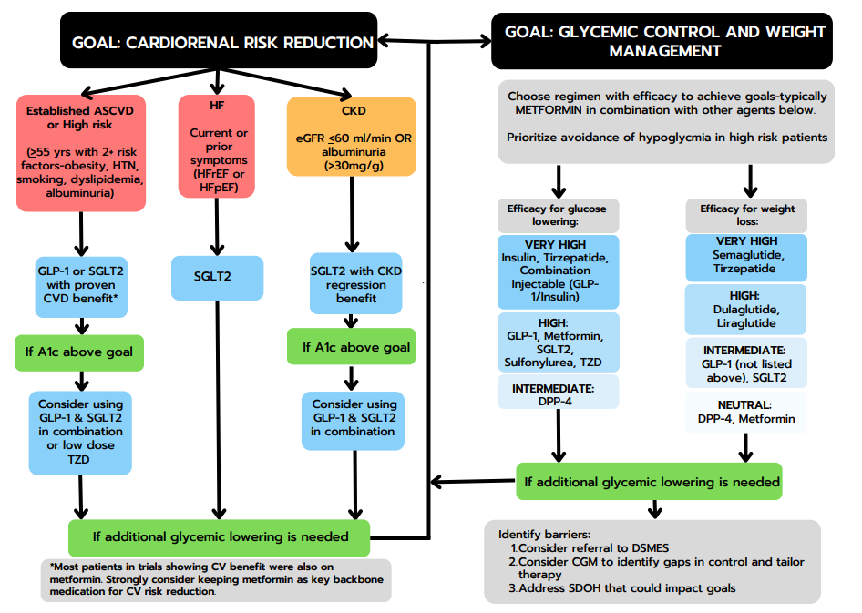
Medications/Pathways
for Type 2 Diabetes
GLP-1 RAgonists w CV benefit includes Liraglutide, semaglutide, and dulaglutide
SGLT2-i all reduce HF admits
With A1c still up, need both
Add low dose TZD as well but if HF avoid
With HF: SGLT2-inhibitors
Renal Concerns
SGLT2i first choice; (Canagliflozin, Dapa-, Empa-) eGFR <60ml/min or albuminuria (>30mg.g), reduce dose of SGLT2i
Consider combination GLP-1 RAg and SGLT2-inhib if A1c elevated
Don’t forget Metformin as baseline medication (use generic XR formulation - specify)

Slide 2
Metformin & TZDs
Product | Dosing | eFGR Dose Adjustment
Metformin | 500mg once or twice daily, titrate weekly to 1000mg twice daily | eGFR 45-60 ml/min: monitor kidney function closely eGFR 30-45: Max dose 500mg twice daily, use caution initiating new therapy eGFR <30: use contraindicated
Adverse Effects: Diarrhea, gas/bloating, nausea/vomiting, reflux
Pearls Typically considered first line treatment and should be used in combination with other classes (GLP-1/SGLT-2) for optimal outcomes Slow dose titration can decrease GI adverse effects (increase by 500mg/day once every 1-2 weeks) Using extended-release product can decrease lower GI adverse effects, but does not decrease bloating/reflux. Take all metformin with food to minimize. Use caution when selecting ER products-some formulations (Glumetza) may be more expensive Monitor B12-can cause deficiency
Product | Dosing | eFGR Dose Adjustment
Pioglitazone | 15-30mg daily (max dose 45mg/day) | none
Adverse Effects: New onset or exacerbation of heart failure (do not use in patients with symptomatic HF) Edema, headache, increase risk of fractures (greater in females)
Pearls Can also decrease TG and increase HDL May be beneficial in patients with prediabetes and history of stroke (without heart failure)

Slide 3
GLP-1 Receptor Agonists
Product​ | Dosing​ | eGFR Dose Adjustment​
Exenatide (Byetta®)​ | 5 mcg BID given 1 hour before meal, may titrate to 10 mcg BID after 4 weeks (Max dose 20 mcg/day) | CrCl <30 ml/min: Do not use
Exenatide ER (Bydureon®)​ | 2mg once weekly​ (no titration) | eGFR <45 ml/min: Do not use
Dulaglutide (Trulicity®)​ | 0.75mg weekly x 4-8 weeks, may increase dose no more often than every 4 weeks (Max dose 4.5mg) | none
Liraglutide (Victoza®)​ | 0.6 mg daily x 1 week then increase to 1.2 mg (minimally effective dose). May increase up to 1.8mg after 1 week | none
Semaglutide (Ozempic®)​ | 0.25 mg x 4 weeks, then increase to 0.5 mg weekly (minimally effective dose). May increase to next pen strength no more often than every 4 weeks (Max dose 2 mg) | none
Semaglutide (Rybelsus®)​ | 3 mg daily x 4 weeks, then increase to 7mg (minimally effective dose). May increase to 14mg daily after 30 days (Max dose 14mg daily) | none
Tirzepatide (Mounjaro®) (GLP-1/GIP agonist, CV trials in progress) | 2.5 mg weekly x 4 weeks, then increase to 5mg weekly (minimally effective dose). May increase in 2.5mg/week increments every 4 weeks to max 15mg/week. | none
Adverse Effects: ​ Nausea, vomiting, diarrhea black box warning against use in patients with family history of medullary thyroid cancer or multiple endocrine neoplasia-2 ​
Pearls: Eating smaller meals with lower fat content (avoid greasy foods) increases GI tolerability Be sure to optimize dosing beyond starting doses after 4 weeks. Continue to increase dose every 4 weeks if BG remain above goals May require lower doses of insulin to avoid hypoglycemia Discontinue if pancreatitis is suspected Avoid use with DPP-4 (no added glucose benefit with increased cost)
*Bolded products have proven CVD benefit

Slide 4
SGLT-2 Receptor Antagonists/Inhibitors
Product​ | Dosing​ | eGFR Dose Adjustment​ | Additional Benefits in Co-morbidities
Canagliflozin (Invokana®)​ | 100mg daily​ 300mg daily​ ​ | eGFR 30-60 ml/min: 100mg/d​ ​eGFR <30 ml/min + >300 mg/d urine albumin: 100mg/d ​ ​eGFR <30 ml/min + <300 mg/d urine albumin: do not use​ (likely ineffective) | Decrease HF hospitalization Reduction in CKD Progression Cardiovascular endpoints
Dapagliflozin (Farxiga®)​ | 5mg daily​ 10mg daily​ ​ | eGFR 25-45 ml/min: likely ineffective for DM, however safe to continue for diabetic kidney disease or HF eGFR <25 ml/min: do not use | Heart Decrease HF hospitalization Reduction in CKD Progression
Empagliflozin (Jardiance®)​ | 10mg daily ​ 25mg daily​ ​ | eGFR< 30 ml/min: likely ineffective for DM eGFR 20-30 ml/min: safely used for HF/CKD ​eGFR <20 ml/min : do not use | Decrease HF hospitalization Reduction in CKD Progression Cardiovascular endpoints
Ertugliflozin (Steglatro®)​ | 5mg daily​ 15mg daily​ | eGFR <45 ml/min​: do not use | Decrease HF hospitalization
Adverse Effects:​ Genital mycotic infections, urinary tract infections, hypotension, volume depletion Pearls: Encourage appropriate hygiene and hydration to minimize adverse effects May need dose reduction in other diuretic therapies Discontinue 3-4 days prior to surgery or any prolonged fasting state (minimize euglycemic DKA)
*Bolded products have proven CVD benefit

Slide 5
DPP-4 Inhibitors
Product | Dosing | eGFR Dose Adjustment
Alogliptin (Nesina®) | 25mg daily | CrCl ≥30-60: 12.5mg daily CrCl <30: 6.25mg daily
Linagliptin (Tradjenta®) | 5mg daily | None
Saxagliptin (Onglyza®) | 5mg daily | eGFR <45: 2.5mg daily
Sitagliptin (Januvia®) | 100mg daily | eGFR ≥30-45: 50mg daily eGFR <30: 25mg daily
Adverse Effects: Nasopharyngitis, pancreatitis (rare)
Pearls: Starting at max dose is recommended (titration not necessary) Avoid use with GLP-1 agonist (no added glucose control at increased cost) Saxagliptin associated with increased hospitalizations for HF in patients with CV disease or CV risk factors Less A1c lowering and no added CV or renal benefit seen with other classes

Slide 6
Insulin Regimen
“Fix Fastings First”
Begin with Basal/long-acting insulin
Lantus (Basaglar), Levemir, Toujeo, Tresiba
Dosing options:
0.1-0.2 units/kg/day OR 10 units daily
Titrations: increase 2 units every 3 days until fasting BG at goal (90-130)
Consider adding meal-time insulin when dose is ~0.5 units/kg
Add Meal-time/rapid-acting insulin if goals not met
Novolog (insulin aspart), Humalog, Lyumjev, Ademelog
Dosing options:
Initiate 4-5 units before largest meal of the day
Titrate by 1-2 units as needed to goal post-prandial BG (<180)
Further intensify by adding to each meal if needed

Slide 7
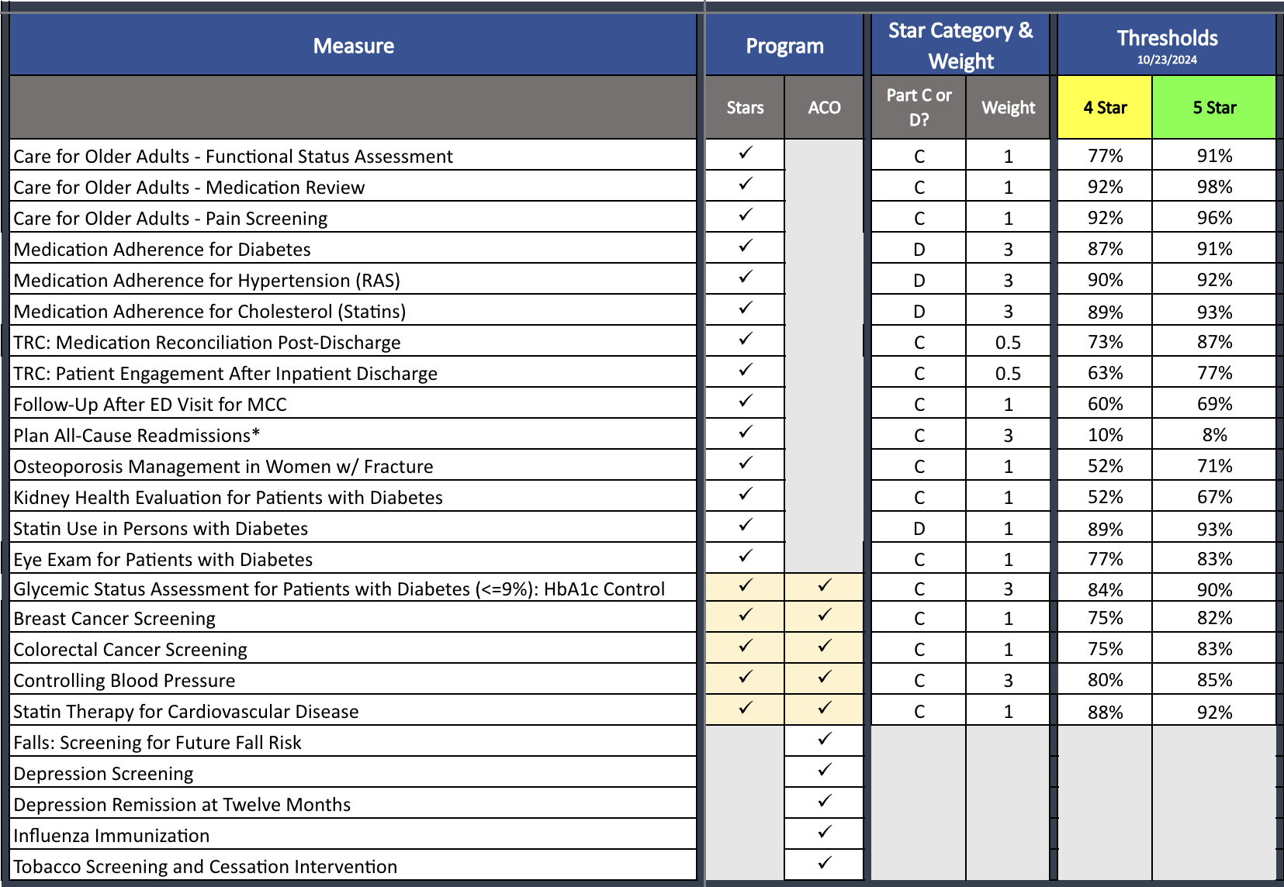
2025 Stars/ACO Quality Metrics (updated 11.2024)

